Slide 1



AIRBNB ACCOMODATION
CIS 8010: Process Innovation

Slide 2
TABLE OF CONTENTS
01
AIRBNB’S OVERVIEW
Service Overview, Business Canvas, SWOT Analysis, Current State of Airbnb, Airbnb Service Process overview, Business Opportunity, Competitive Advantage
02
IDENTIFIABLE MOS AND CVM
Target Customers, Job to be done, the big problem, Identifiable Moment of Struggles, Related Job Steps, Moment of Struggle Impact, Estimate
03
APPLY VLIFT PROCESS TO MOS
Apply VLIFT Process to Calender Synchronization Issues, Pricing Discrepancies, Verification Requirement, Lack of Instant Booking, and Unclear Policy; Maximize Service
04
VLIFT IMPLEMENTATION AND ITS OUTCOME
Enhancing Customer Experience Summary, Airbnb Finances and VLIFT Implementation, VLIFT Implementation: Time and Resources

Slide 3
SERVICE OVERVIEW
$ 3.5 B Additional Gross Booking Value
193 Countries
Airbnb Complaints - 127,183
$ 740 M Booking Revenue Decrease
Provider: Airbnb, Inc.
Operation: Global Accommodation Network
Accessibility: Website, Mobile App
Customization: Personalized Searches
Customer Service Issue - 72%
100,00 Cities
$ 36 M Revenue Decrease for Sync. Issues
8.3 B $ Revenue in 2022
Scams - 22.3%
Host Cancels Stay – 10.4%
1.8 B Earning in 2022
$ 60 M Legal Dispute

Slide 4
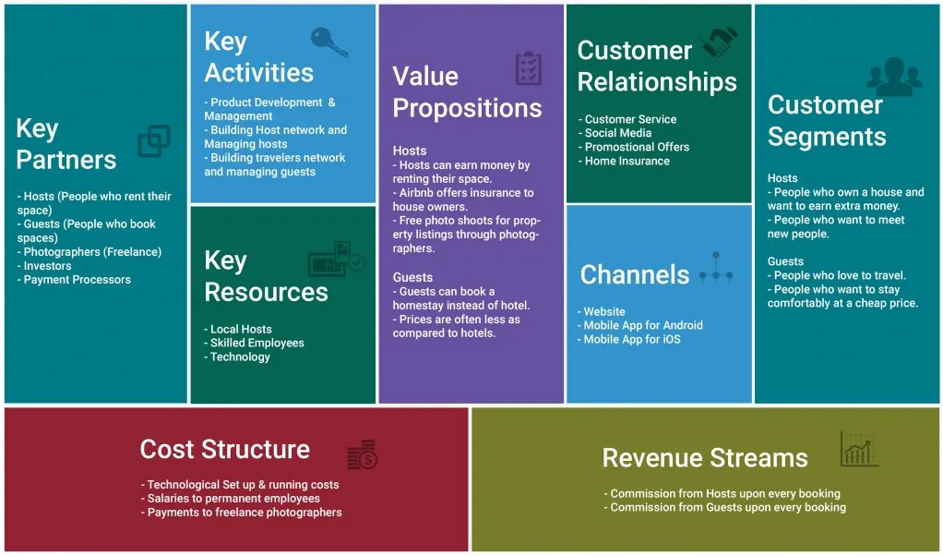
BUSINESS CANVAS

Slide 5




SWOT ANALYSIS
S
STRENGTHS
WEAKNESSES
W
Strong brand recognition
Diverse accommodation options
User-friendly platform
Community-driven model
Quality control concerns
Dependency on host retention
Vulnerability to external factors
Competition from similar industry
O
OPPORTUNITIES
THREATS
T
Expansion into new markets
Partnerships and collaborations
Investment in technology
Sustainable and responsible tourism
Regulatory crackdowns
Security and safety concerns
Competitive pressures
Technological disruption

Slide 6
AIRBNB SERVICE PROCESS OVERVIEW
Account Creation
Main Booking
Payment Processing
Post-Stay Processes
Interface: Customer starts account.
Process: Managed in Account Department.
Touchpoints: ID verification challenges.
Roles: Staff verify; IT assists.
Interface: Booking follows account.
Process: Handled by Booking Department.
Touchpoints: Housing data discrepancies.
Roles: Dept manages; IT facilitates.
Interface: Payment post-booking.
Process: Managed by Payment Department.
Touchpoints: Payment detail issues.
Roles: Staff verify; IT handles.
Interface: Post-payment processes.
Process: Reviews collection, receipt generation.
Touchpoints: Review, receipt challenges.
Roles: Staff collect; IT finalizes.
1
2
3
4
Notes:
Target Customers Who are they? What “job” are they trying to get done? How are they struggling to get that job done? (BIG Problem)

Slide 7

Human resources slide 7
TARGET CUSTOMERS
TRAVELER PROFILE
“JOB“ TO BE DONE
BIG PROBLEM:
Book a place to stay during travel
Seek a personalized and convenient experience
Utilize customizable search, booking, and check-in options
Lack of listing transparency
Difficulty finding specific preferences
Seek personalized lodging experiences
Value convenience and customization

Slide 8
IDENTIFIABLE MOS AND CVM
Pricing Discrepancies
Related Job Step : Booking
MoS: Trust Issues
CVM: Transparency Index
Impact: Reduce Confusion
…
Calendar Sync
Related Job Step: Search Selection
MoS: Time Wasted
CVM: Accuracy Rate
Impact: Reduces Re-searching
Verification Hassle
Slow Booking
Related Job Step : Account Setup
MoS: User Deterrence
CVM: Efficiency
Impact: Accelerate Booking
Related Job Step : Confirmation
MoS: Guest Loss
CVM: Response Rate
confirmation
Impact: Improve Experience

Slide 9

VLIFT PROCESS FOR PRICING DISCREPANCIES IMPROVEMENT
01
Address Service Gaps
Tailored Service Segmentation
Shift Customer Side Complexity
Remove Slack Rope
Proposed Improvement Rationalization
Real-time price adjustments
Accurate total cost reflection
Resource allocation for high-demand segments
Segment-specific instant booking features
Streamlined booking steps
Automated customer preferences
Wasteful step elimination
Error reduction through Six Sigma
Instant booking performance monitoring
Customer feedback utilization
Dynamic pricing information integration
Reduced variance (< 10%)
Transparent pricing calculations
Notes:
Firstly, we're introducing Dynamic Pricing Information for real-time price adjustments, ensuring our customers see the most accurate cost. We're prioritizing Instant Booking for high-demand segments, with features tailored to their needs. Our Simplified Booking Interface will streamline the process and remember customer preferences, while Lean Processes will cut waste and reduce errors through Six Sigma. Lastly, we will use customer feedback for Improvement Rationalization, refining our instant booking performance

Slide 10
VLIFT PROCESS FOR INSTANT BOOKING ENHANCEMENT
02
Address Service Gaps
Tailored Service Segmentation
Shift Customer Side Complexity
Remove Slack Rope
Proposed Improvement Rationalization
Efficient request handling
Real-time availability checks
Resource allocation optimization
Segment-specific features implementation
Minimized booking steps
Automated customer preferences
Eliminate wasteful steps
Error reduction through Six Sigma
Track instant booking performance
Act on customer feedback
Simplified booking interface and processes
Instant booking response rate ≥ 90%
Prioritized high-demand segments
Notes:
Moving on, to enhance instant booking, we are upgrading our technology infrastructure for efficient request handling and real-time checks. High-demand segments will receive prioritized resources, and we'll simplify the booking interface to minimize steps. Lean processes will continue to remove waste, and we're committed to Continuous Improvement by tracking performance and acting on customer feedback

Slide 11
VLIFT PROCESS FOR CALENDAR SYNC ENHANCEMENT
03
Address Service Gaps
Tailored Service Segmentation
Shift Customer Side Complexity
Remove Slack Rope
Proposed Improvement Rationalization
Complex scenario handling
High accuracy rates assured
Business user enhancements
Personal user simplification
Background synchronization management
Smart error handling algorithms
Streamlined process application
Six Sigma for quality improvement
Set ambitious targets
Apply VLIFT strategies
Enhance value, satisfaction
Address gaps, competitive advantage
Seamless integration with major calendar platforms
Increased accuracy rate (> 98%)
Real-time updates and alerts
Notes:
In our third process, we're addressing service gaps with complex scenario handling and assured accuracy. We will offer Tailored Service Segmentation, enhancing features for business users and simplifying for personal users. The goal is to reduce customer-side complexity with smart algorithms and to integrate major calendar platforms seamlessly for real-time updates

Slide 12
VLIFT PROCESS FOR VERIFICATION REQUIREMENTS ENHANCEMENT
04
Address Service Gaps
Tailored Service Segmentation
Shift Customer Side Complexity
Remove Slack Rope
Proposed Improvement Rationalization
AI-based automation tools
Real-time verification integration
Tailored verification levels
Service type differentiation
Streamlined document upload
Mobile device scanning
Eliminate redundant steps
Six Sigma for variation reduction
Monitor verification metrics
Adapt based on feedback and innovation
Enhanced user convenience and satisfaction
Average verification time reduced by 90%
Automated processes implementation
Notes:
Next, we're automating verification processes with AI tools and real-time integration. Segment-specific protocols will ensure service differentiation. User submission will become simpler through mobile device scanning and a streamlined document upload process. We'll apply Lean Workflows to cut redundancy and use Six Sigma for variation reduction, monitoring and adapting verification metrics based on feedback

Slide 13
MAXIMIZING SERVICE THROUGH VLIFT STRATEGIES
INSTANT BOOKING RESPONSE RATE
VLIFT METHODOLOGY
PRICING TRANSPARENCY
Enhances service value.
Addresses customer dissatisfaction.
Improves Airbnb experience.
< 5% Variance from initial price
Real-time Calculators
Clear Breakdowns Provided
90% Instant Booking
Real-time Integration
Peak Time Prioritization
CALENDAR SYNC
VERIFICATION PROCESS EFFICIENCY
90% Accuracy between platforms
Real-time Updates
Major Platform Integration
Reduce Verification Time by 90%
Automated Verification using ML
Streamlined Re-verification
Notes:
To summarize Anitta presentation, we came up with 4 major innovative VLIFT Strategies that can help Airbnb to add additional value to their existing business and improve Customer’s experience.
For Calender synchronization, we are looking at an increase to 90% of accuracy between booking platforms, that will update automatically
With the Verification process, with the implementation of AI and machine learning, we are looking at a reduction of verification time by 90%. From waiting for human interaction to examine your documentation to instant scanning and processing.
With the new pricing transparency update. We want to update the customer with a showing price of less than 5% variance from the final price ( ofc not accounting for tax).
Finally, with the instant booking setting, we are looking at an adoption rate from the host of up to 90%. Reducing the waiting time for customer.

Slide 14
AIRBNB FINANCE AND VLIFT IMPLEMENTATION
Airbnb 2023 Financial Highlights
(in millions)
Operations and Support: $1,186 million
VLIFT Impact Focus: Operations and Support
Personnel-related expenses
Customer support via phone, email
Customer relations costs, refunds
Host protection programs
Allocated facilities and IT costs
Gross Booking Value: $ 73.2M
Total booking: 448 (M) booking
Average per Booking: $165
Notes:
Extracted from Airbnb Financial Statement, this helps us to give an overall estimated projection of how the VLIFT implementation can add value to Airbnb.
I just want to bring you guys to several important numbers. In 2023, Airbnb had a total of 448M booking, conversing to almost $ 73B in gross revenue.
Please also look at their operation and support cost of $1.1B.This is mainly the cost that Airbnb expensed on customer support, IT costs and several operating cost. We will mainly use this cost for our revenue and budget projection

Slide 15
ENHANCING CUSTOMER EXPERIENCE SUMMARY
Instant Booking Implementation
Verification Process Enhancement
PI: $2.2B Gross Booking Value boost from volume.
PI: $36M savings from disputes reduction.
02
04
PI – Profitability Impact
01
03
Pricing Transparency Enhancement
Calendar Synchronization Improvement
PI: $750M booking revenue increase from additional customer conversion.
PI: $60M savings from disputes reduction.
Notes:
Projection of a 3% reduction in Operations and Support
The expenses for "Operations and Support" are $1,186 million
$1,186 million×3%= ~ $36 million
The expenses for "Operations and Support" are $1,186 million
$1,186 million×5% = $60 million
We projected an increase of 3% increase in booking from Instant Booking policies
448(M) * 3% = 13.4 (M) of additional booking
13.4(M) * $165 per booking = $2.2 (M)
Projected an increase of 1% increase in booking from improved Conversation Rate:
448(M) * 1% = 4.5 (M) of additional booking
4.5(M) * $165 per booking = $740 (M)

Slide 16
VLIFT IMPLEMENTATION: TIME & RESOURCES
BUDGET CATEGORIES
Calendar Sync: $1M - $1.5M
Instant Booking: $1M - $1.5M
Pricing Transparency: $1.5M - $2M
Verification Efficiency: $2M - $3M
TIMELINE
Overall Duration: 12-24 months
Development: 6-9 months
Integration & Testing: 4-6 months
Rollout & Optimization: 2-9 months
RESOURCE NEEDED
Project Management
Software Development Team
Quality Assurance Team
Data Analysts & AI/ML Engineers
Total Estimated Budget Range:
$5M - $7M
Plus 10-20% contingency for unforeseen expenses.
Notes:
Calender sync: comparing pricing to existing prebuilt online system
Instant booking & Dynamic Pricing: compared cost from a detail analysis from a research on how to build a rental marketing website.
Verification: Calculate based on5% of $1.7B Airbnb spent on Project development.

Slide 17
THANK YOU
Group 6​
Anitta Varghese
Md Kamruzzaman Kamrul
Ritesh Sengar
Bach Hong

